Slide 1

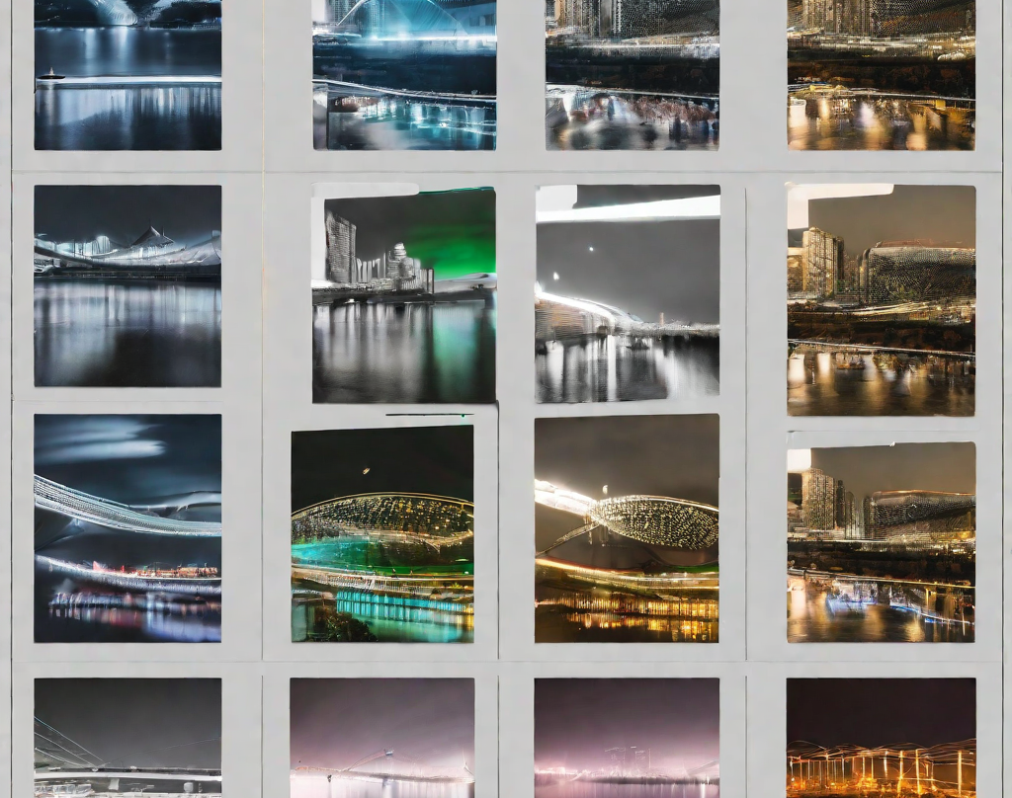
Image Classification Using Deep Learning
Name: Gauri Gupta
Sec: D
Sem: 5
Roll No.: 21
Mentor Name: Prof. Ashwini Kumar

Slide 2
Objective
To develop a robust and accurate plant disease detection system using deep learning techniques for image classification.
This project aims to enhance agricultural productivity and reduce crop losses by leveraging state-of-the-art deep learning models to identify and classify diseases in plants based on visual symptoms captured in images.
Problem Statement: A trained deep learning model capable of accurately classifying plant diseases from images using deep learning.

Slide 3
Important Libraries
NumPy (np):
Use: NumPy is used for numerical operations and handling multi-dimensional arrays. It's a fundamental library for scientific computing with Python.
Pandas (pd):
Use: Pandas is used for data manipulation and analysis. It provides data structures like DataFrame for efficient data handling.
Matplotlib.pyplot (plt):
Use: Matplotlib is a plotting library, and pyplot is a collection of functions in Matplotlib that allow for creating various types of plots.
TensorFlow and Keras:
Use: TensorFlow is an open-source machine learning library, and Keras is a high-level neural networks API running on top of TensorFlow. They are used for building and training deep learning models.
TensorFlow Lite (tf.lite):
Use: TensorFlow Lite is used for optimizing and deploying machine learning models on mobile and edge devices

Slide 4
Deep Learning for Image Classification Deep learning has revolutionized image classification by enabling machines to learn features directly from raw pixel data. This allows for highly accurate and efficient image recognition, even in complex and diverse datasets.
Convolutional Neural Networks
Convolutional neural networks (CNNs) are a popular deep learning technique for image classification. They use convolutional layers to extract features from images, which are then passed through fully connected layers to make predictions.
It uses complex algorithms and artificial neural networks to train machines/computers so that they can learn from experience, classify and recognize data/images just like a human brain does.
For eg: used for image recognition, object detection, facial recognition, medical image analysis, self-driving cars, and more.
Tensorflow Framework
The Tensorflow framework is an open end-to-end machine learning platform. It's a symbolic math toolkit that integrates data flow and differentiable programming to handle various tasks related to deep neural network training and inference.
TensorFlow allows you to create dataflow graphs that describe how data moves through a graph
For eg: Keras is the high-level API of the TensorFlow platform: an approachable, highly-productive interface for solving machine learning problems, with a focus on modern deep learning.

Slide 5
Real World Applications
Medical Imaging
Deep learning models can be trained to classify medical images, such as X-rays and CT scans, to assist healthcare professionals in diagnosing and treating patients. For example, a deep learning model can be trained to detect early signs of lung cancer in chest X-rays.
Agriculture
Deep learning models can be used to classify crops and identify weeds, allowing farmers to optimize their use of herbicides and pesticides. They can also be used to monitor crop growth and predict yields, helping farmers make more informed decisions about planting and harvesting.
Autonomous Vehicles
Image classification using deep learning is a key technology for autonomous vehicles. Deep learning models can be used to identify objects on the road, such as other vehicles, pedestrians, and traffic signs, allowing the vehicle to make decisions and take actions in real-time.

Slide 6
Problem Faced
Users often encounter challenges due to the limited availability of diverse and well-labeled datasets for training deep learning models.
Plant diseases can manifest in various ways, influenced by factors such as environmental conditions, plant species, and stages of disease progression. The lack of a comprehensive and diverse dataset can hinder the model's ability to generalize effectively and accurately identify diseases across different scenarios.
This issue may lead to misclassifications or reduced performance when the model encounters new, unseen variations in plant diseases.
Collecting and curating a representative dataset that captures the full spectrum of plant diseases under different conditions is crucial for improving the robustness and reliability of the deep learning model.

Slide 7
Solutions
Data Augmentation:
Implement data augmentation techniques to artificially increase the size of the training dataset. Techniques such as rotation, flipping, zooming, and color adjustments can help expose the model to a more extensive range of variations in the input data.
Transfer Learning:
Leverage pre-trained deep learning models on large-scale datasets, such as ImageNet. Fine-tune these models on the available plant disease dataset. Transfer learning allows the model to inherit knowledge gained from diverse datasets, potentially improving performance on the target task with a limited dataset.
Active Learning:
Implement active learning strategies to intelligently select and query instances that are most informative or uncertain to human annotators. This approach helps prioritize the labeling of samples that are critical for improving model performance and generalization.

Slide 8
Reference
Research Paper on Image Classification using deep learning
https://www.researchgate.net/publication/325116934_Image_cl assification_using_Deep_learning
https://en.wikipedia.org/wiki/Convolutional_neural_network

Slide 9
Thank You!

